Slide 1

TEAM NO: 1096 BINARY BEAST
BHAGWAN PARSHURAM INSTITUTE OF TECHNOLOGY
Team Leader: Rupesh Dembla
Team Members: Tushar Sethi
Stuti Dabral
Vaibhav Agria

Slide 2
Problem Statement ~ As the Covid-19 pandemic unfolded across the world, one of the greatest barriers we encountered was the absence of credible and consistent data.
Description of the idea ~
• The COVID Dashboard Project collects and publishes the most complete testing data available for all countries in the world.
• Our goal for the global visualisations is twofold:
1) to provide a snapshot of the pandemic based on the latest computed estimates and
2) to provide a comparative plot exposing the progress of the virus in multiple countries.

Slide 3
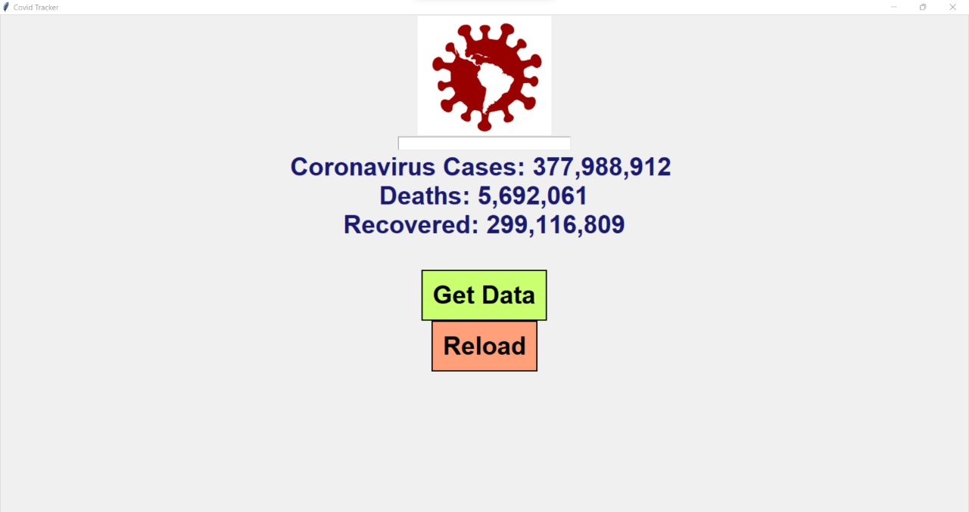
Solution ~
Lockdowns create two major challenges. First, they impose severe rights-restrictions on individuals. Second, they incur vast economic, social and psychological costs. Hence, there is high pressure upon governments to find strategies to contain the pandemic and simultaneously exit the lockdown.
One such strategy is the use of digital Covid tracing.
Prototype ~
START
Fetching data from website URL.
Applying GUI to give it graphical features.
Adding buttons for getting the data or searching the data.
Search box provided to search a country.
Giving it a background colour
STOP

Slide 4
Description of the technology ~
•The data collection subsystem consists of 1) a user-centered web front-end interface (GUI), providing a straightforward and intuitive access to the surveys, and
2) a data collection back-end (Python & TKINTER) enabling response aggregation in a consistent and structured format to facilitate post-processing.
Applicability ~
During the current coronavirus pandemic, monitoring the evolution of COVID-19 cases is of utmost importance for the authorities to make informed policy decisions (e.g., lock-downs), and to raise awareness in the general public for taking appropriate public health measures.

